Slide 1
Chapters
Introduction
core concepts
Definitions
Architecture Development Method
ADM Guidelines and Techniques
Architecture Content Framework
Enterprise continuum and Tools
Architecture Capability Framework

Slide 2
What is TOGAF?
TOGAF is the most used framework for enterprise architecture as of 2020 that provides and approach for designing, planning, implementing and governing an enterprise information technology.
It may be used freely by any organization wishing to develop an Enterprise Architecture for use within that organization.
The original development of TOGAF Version 1 in 1995 was based on the Technical Architecture Framework for Information Management (TAFIM), developed by the US Department of Defense (DoD)

Slide 3
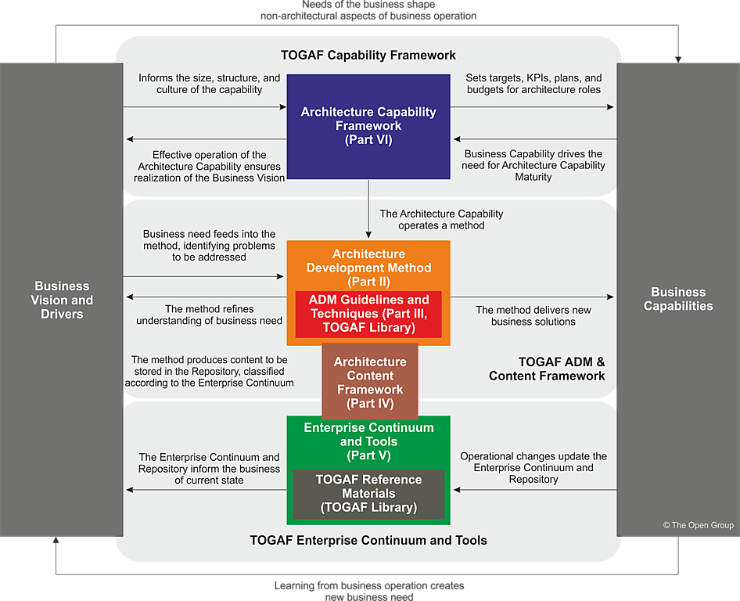
Structure of the TOGAF Standard
There are six part of this document
Introduction.
Architecture Development Method.
ADM Guidelines and Techniques.
Architecture Content Framework.
Enterprise Continuum & Tools.
Architecture Capability Framework .

Slide 4
What is Enterprise ? The TOGAF standard considers an "enterprise" to be any collection of organizations that have common goals. * A whole corporation or a division of a corporation * A government agency or a single government department * A chain of geographically distant organizations linked together by common ownership * Groups of countries or governments working together to create common or shareable deliverables or infrastructures * Partnerships and alliances of businesses working together, such as a consortium or supply chain What is an architecture framework? An architecture framework is a foundational structure, or set of structures, which can be used for developing a broad range of different architectures. It should describe a method for designing a target state of the enterprise in terms of a set of building blocks, and for showing how the building blocks fit together. It should contain a set of tools and provide a common vocabulary. It should also include a list of recommended standards and compliant products that can be used to implement the building blocks. Why is an enterprise Architecture needed? The purpose of Enterprise Architecture is to optimize across the enterprise the often fragmented legacy of processes (both manual and automated) into an integrated environment that is responsive to change and supportive of the delivery of the business strategy Why use the TOGAF standard as a Framework for Enterprise Architecture? The TOGAF standard has been developed through the collaborative efforts of the whole community. Using the TOGAF standard results in Enterprise Architecture that is consistent, reflects the needs of stakeholders, employs best practice, and gives due consideration both to current requirements and the perceived future needs of the business.

Slide 5
Who would benefit from using TOGAF Standards.
Any organization undertaking, or planning to undertake, the development and implementation of an Enterprise Architecture for the support of business transformation will benefit from use of the TOGAF standard

Slide 6
CORE CONCEPTS
What is TOGAF Standard? The TOGAF standard is an architecture framework. It provides the methods and tools for assisting in the acceptance, production, use, and maintenance of an Enterprise Architecture. It is based on an iterative process model supported by best practices and a re-usable set of existing architecture assets.
What is Architecture in the Context of the TOGAF Standard? "The fundamental concepts or properties of a system in its environment embodied in its elements, relationships, and in the principles of its design and evolution”.
What kind of Architecture does the TOGAF deal with ? Business Architecture : defines the business strategy, governance, organization, and key business processes Data Architecture: describes the structure of an organization's logical and physical data assets and data management resources Application Architecture : provides a blueprint for the individual applications to be deployed, their interactions, and their relationships to the core business processes of the organization Technology Architecture : describes the logical software and hardware capabilities that are required to support the deployment of business, data, and application services; this includes IT infrastructure, middleware, networks, communications, processing, standards, etc

Slide 7
Architecture Development Method
The TOGAF Architecture Development Method (ADM) provides a tested and repeatable process for developing architectures. The ADM includes establishing an architecture framework, developing architecture content, transitioning, and governing the realization of architectures.
All of these activities are carried out within an iterative cycle of continuous architecture definition and realization that allows organizations to transform their enterprises in a controlled manner in response to business goals and opportunities
Phases within the ADM are as follows:
The Preliminary Phase describes the preparation and initiation activities required to create an Architecture Capability including customization of the TOGAF framework and definition of Architecture Principles
Phase A: Architecture Vision describes the initial phase of an architecture development cycle
It includes information about defining the scope of the architecture development initiative, identifying the stakeholders, creating the Architecture Vision, and obtaining approval to proceed with the architecture development.
Phase B: Business Architecture describes the development of a Business Architecture to support the agreed Architecture Vision.
Phase C: Information Systems Architectures describes the development of Information Systems Architectures to support the agreed Architecture Vision

Slide 8
Architecture Development Method
Phase D: Technology Architecture describes the development of the Technology Architecture to support the agreed Architecture Vision
Phase E: Opportunities & Solutions conducts initial implementation planning and the identification of delivery vehicles for the architecture defined in the previous phases
Phase F: Migration Planning addresses how to move from the Baseline to the Target Architectures by finalizing a detailed Implementation and Migration Plan
Phase G: Implementation Governance provides an architectural oversight of the implementation
Phase H: Architecture Change Management establishes procedures for managing change to the new architecture
Requirements Management examines the process of managing architecture requirements throughout the ADM

Slide 9
Deliverables : is a work product that is contractually specified and in turn formally reviewed, agreed, and signed off by the stakeholders, Deliverables represent the output of projects and those deliverables that are in documentation form will typically be archived at completion of a project, or transitioned into an Architecture Repository as a reference model, standard, or snapshot of the Architecture Landscape at a point in time. Artifacts : is an architectural work product that describes an aspect of the architecture. Artifacts are generally classified as catalogs (lists of things), matrices (showing relationships between things), and diagrams (pictures of things). Examples include a requirements catalog, business interaction matrix, and a use-case diagram. An architectural deliverable may contain many artifacts and artifacts will form the content of the Architecture Repository. A Building Block : represents a (potentially re-usable) component of enterprise capability that can be combined with other building blocks to deliver architectures and solutions. Architecture Building Blocks (ABBs): typically describe required capability and shape the specification of Solution Building Blocks (SBBs); for example, a customer services capability may be required within an enterprise, supported by many SBBs, such as processes, data, and application software. Solution Building Blocks(SBBs): represent components that will be used to implement the required capability; for example, a network is a building block that can be described through complementary artifacts and then put to use to realize solutions for the enterprise

Slide 10
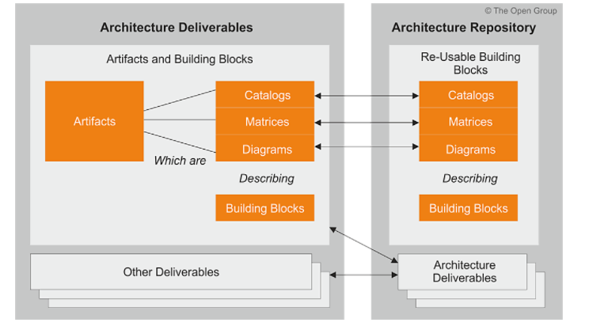
Relationship between Deliverables, Artifacts and Building Blocks.
For example, an Architecture Definition Document is a deliverable that documents an Architecture Description. This document will contain a number of complementary artifacts that are views of the building blocks relevant to the architecture. For example, a process flow diagram (an artifact) may be created to describe the target call handling process (a building block). This artifact may also describe other building blocks,

Slide 11
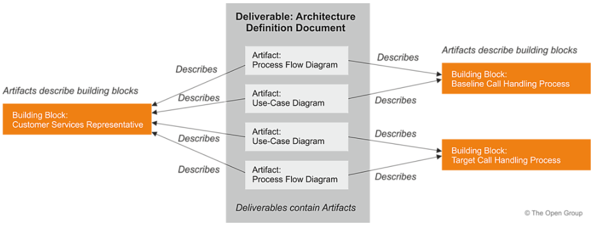
Relationship between Deliverables, Artifacts and Building Blocks.

Slide 12
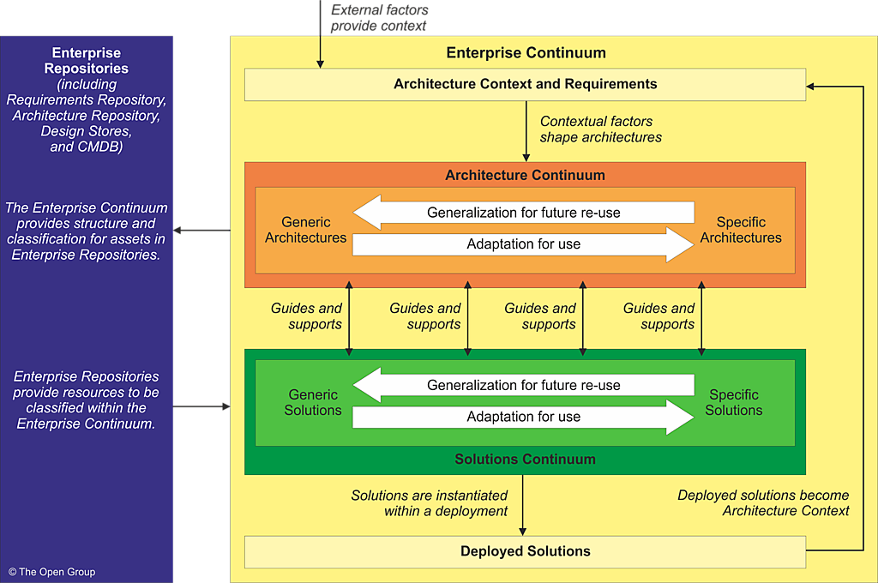
Enterprise Continuum
The Enterprise Continuum is a view of the Architecture Repository that provides methods for classifying architecture and solution artifacts as they evolve from generic Foundation Architectures to Organization-Specific Architectures.
The Enterprise Continuum comprises two complementary concepts: the Architecture Continuum and the Solutions Continuum.

Slide 13
Architecture Repository
Supporting the Enterprise Continuum is the concept of an Architecture Repository which can be used to store different classes of architectural output at different levels of abstraction, created by the ADM. In this way, the TOGAF standard facilitates understanding and co-operation between stakeholders and practitioners at different levels.
By means of the Enterprise Continuum and Architecture Repository, architects are encouraged to leverage all other relevant architectural resources and assets in developing an Organization-Specific Architecture.
The major components within an Architecture Repository are as follows: The Architecture Metamodel describes the organizationally tailored application of an architecture framework, including a metamodel for architecture content
The Architecture Capability defines the parameters, structures, and processes that support governance of the Architecture Repository
The Architecture Landscape is the architectural representation of assets deployed within the operating enterprise at a particular point in time - the landscape is likely to exist at multiple levels of abstraction to suit different architecture objectives
The Standards Information Base (SIB) captures the standards with which new architectures must comply, which may include industry standards, selected products and services from suppliers, or shared services already deployed within the organization
The Reference Library provides guidelines, templates, patterns, and other forms of reference material that can be leveraged in order to accelerate the creation of new architectures for the enterprise
The Governance Log provides a record of governance activity across the enterprise
The Architecture Requirements Repository provides a view of all authorized architecture requirements which have been agreed with the Architecture Board
The Solutions Landscape presents an architectural representation of the SBBs supporting the Architecture Landscape which have been planned or deployed by the enterprise

Slide 14
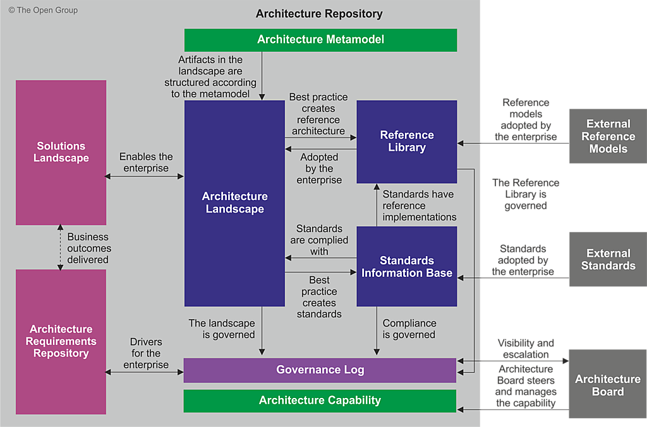
Architecture Repository

Slide 15
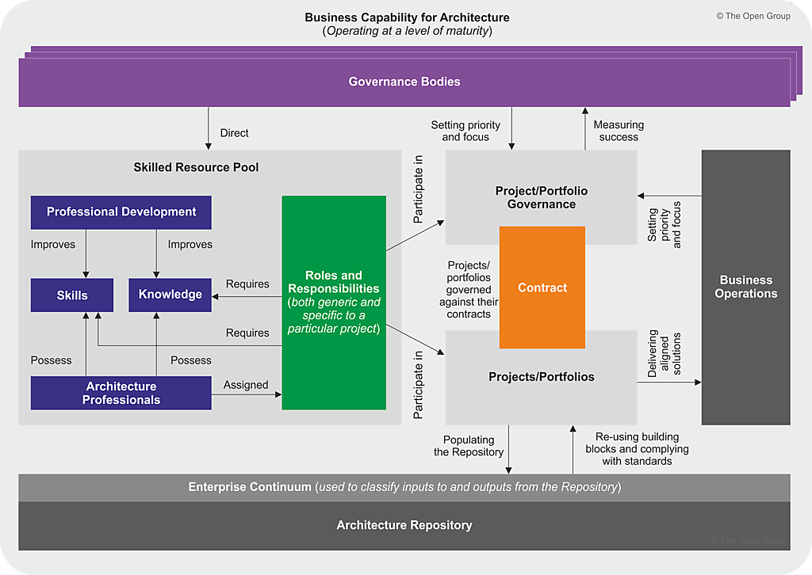
Enterprise Architecture Capability

Slide 16
Architecture Development Method
It describes a method for developing and managing the lifecycle of an Enterprise Architecture, and forms the core of the TOGAF standard. It integrates elements of the TOGAF standard described in this document as well as other available architectural assets, to meet the business and IT needs of an organization.

Slide 18
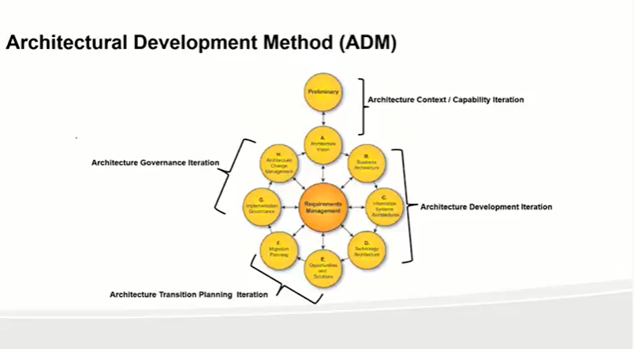

Slide 19
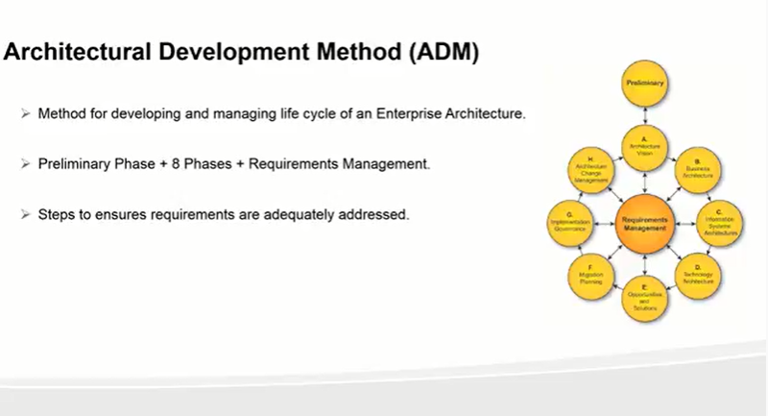

Slide 20
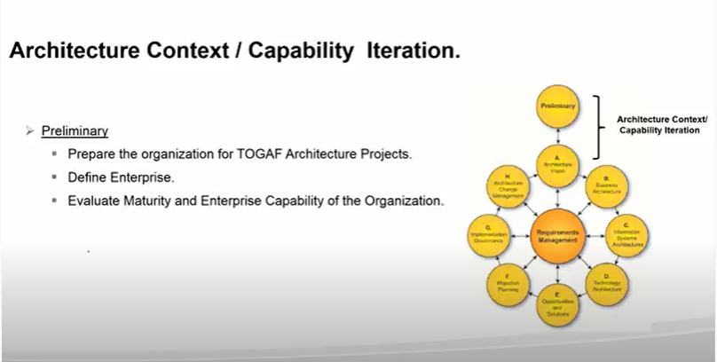

Slide 21
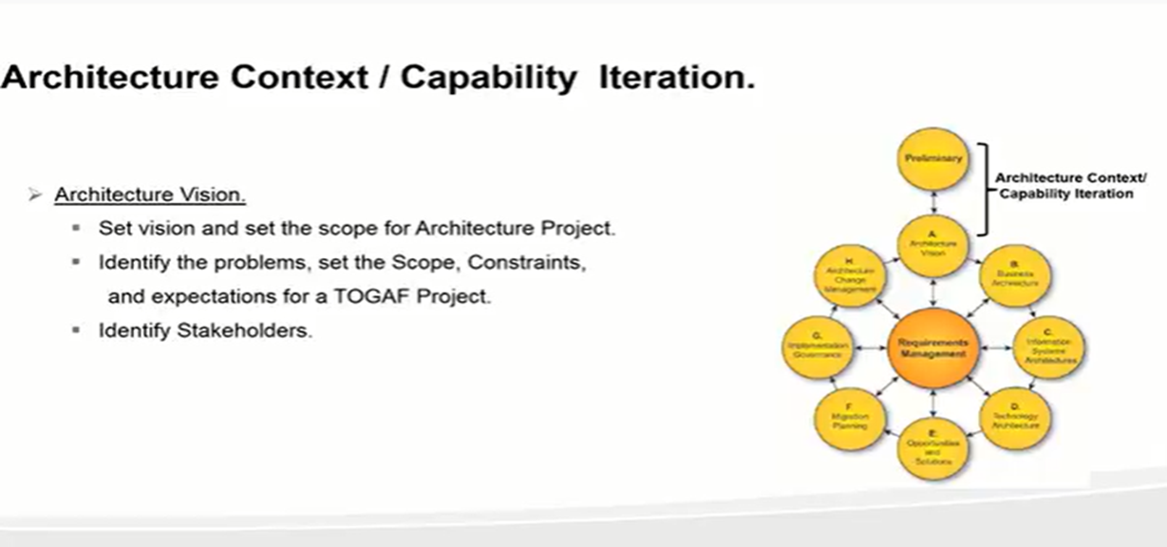

Slide 22
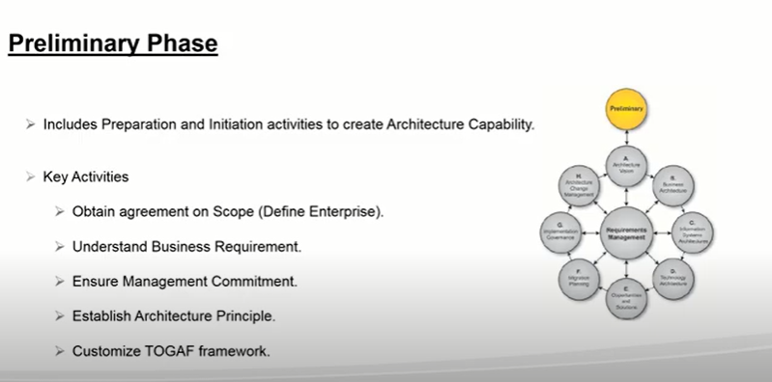

Slide 23
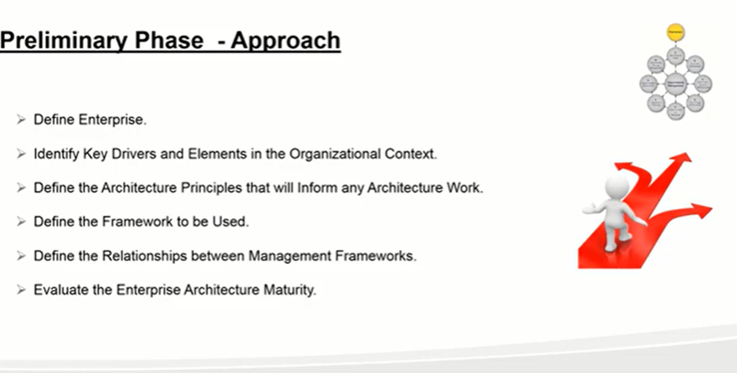

Slide 24
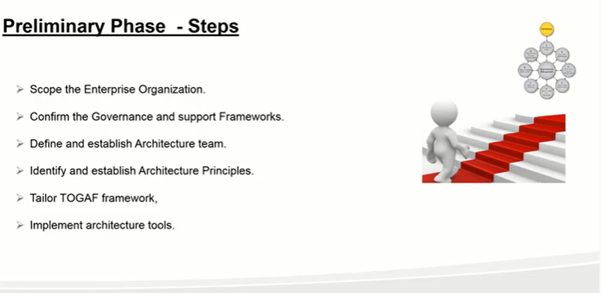

Slide 25
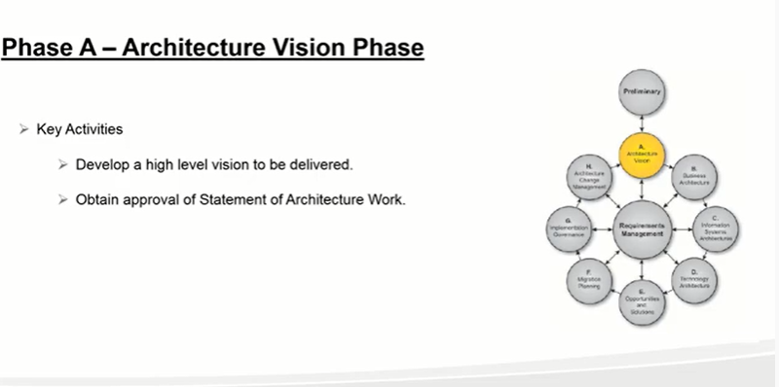

Slide 26
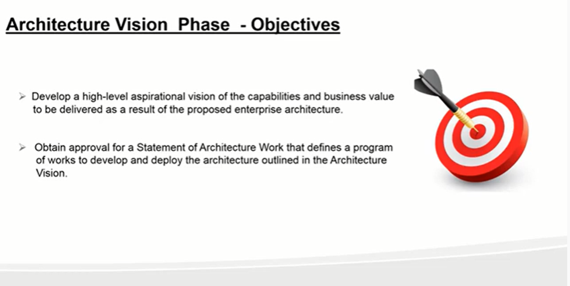
sfaasfas

Slide 27
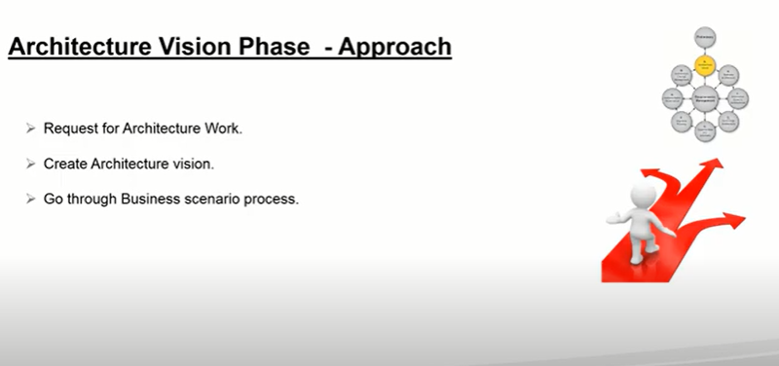
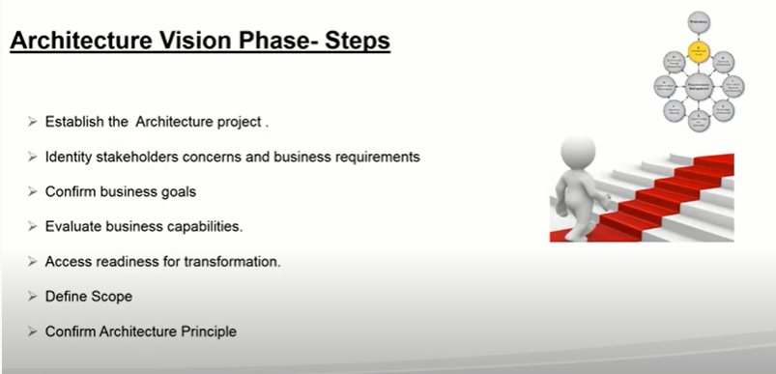

Slide 28
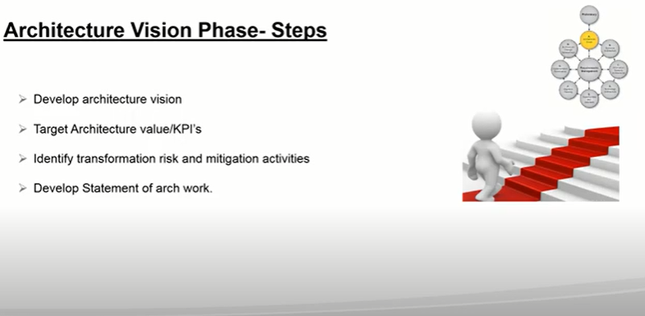

Slide 29
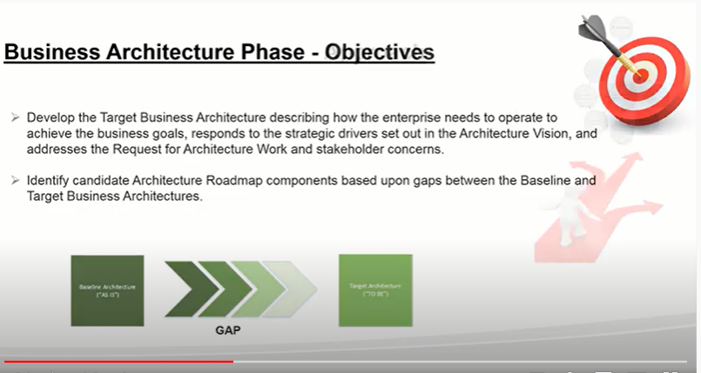
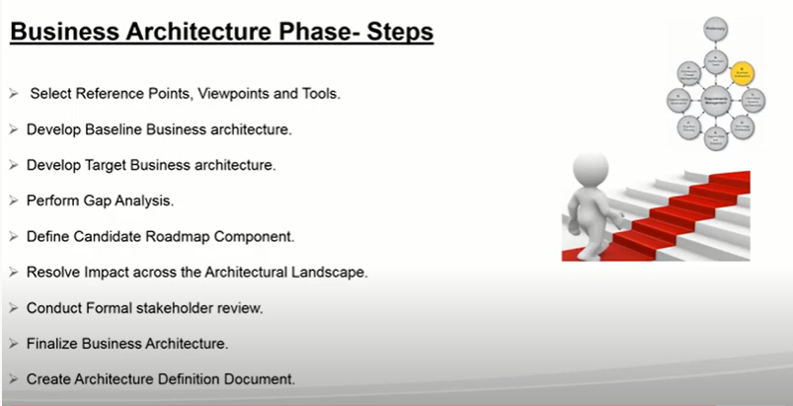
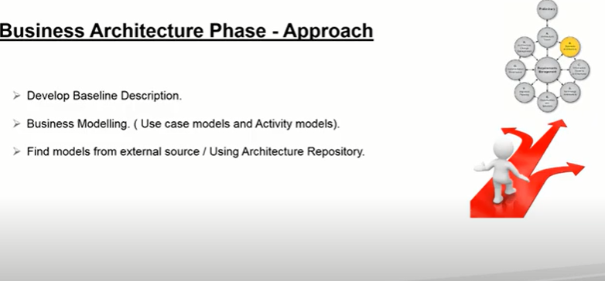

Slide 31
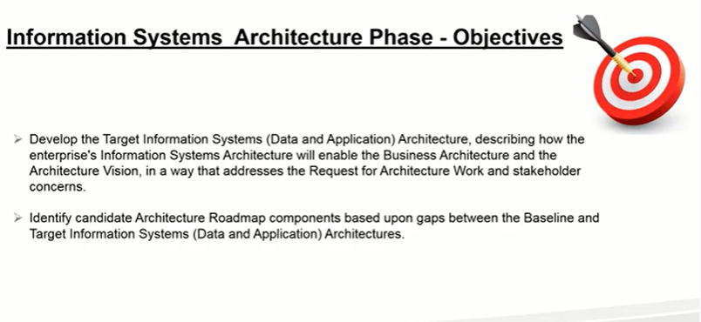
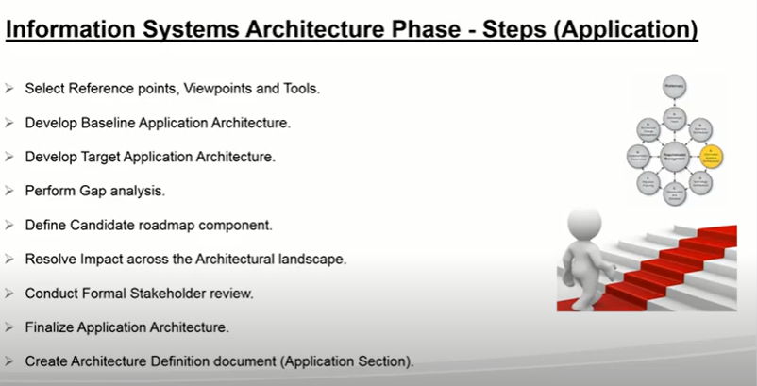
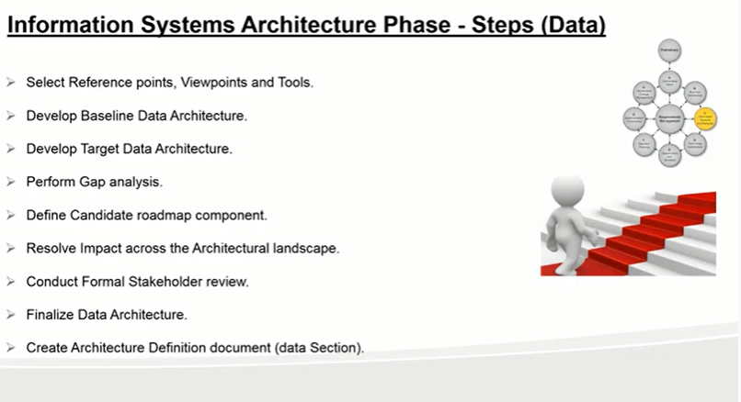

Slide 32
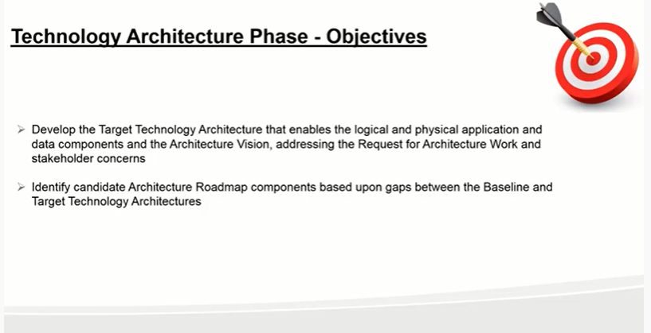
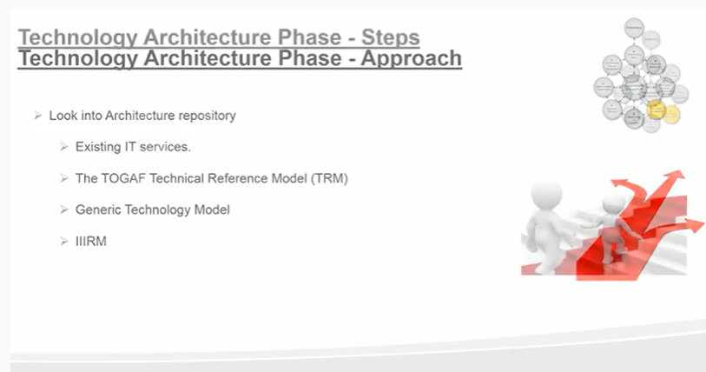

Slide 33
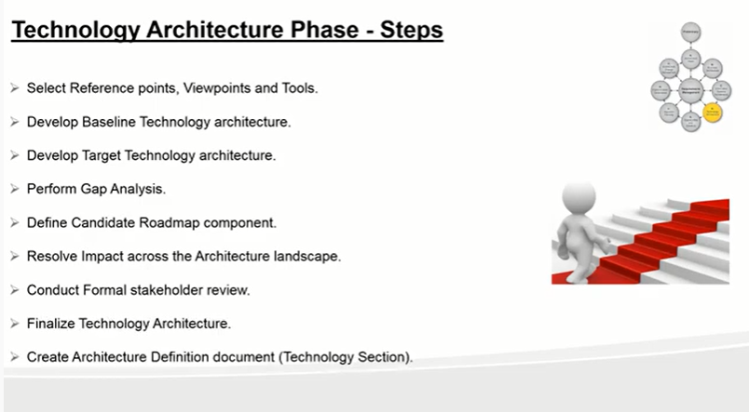

Slide 34
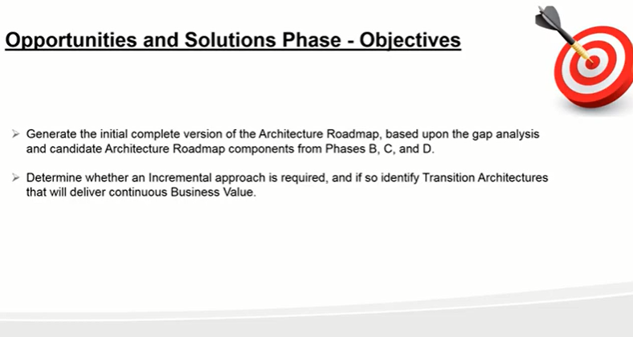
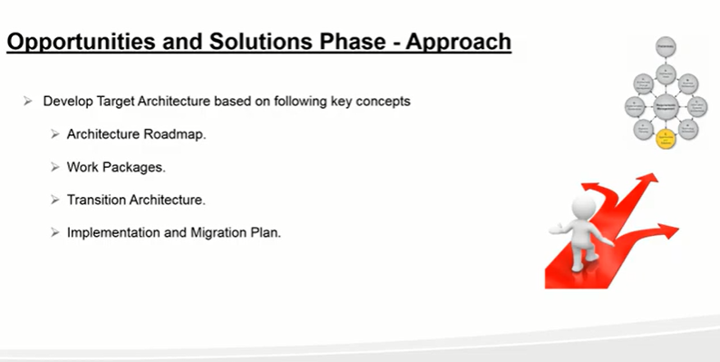

Slide 35
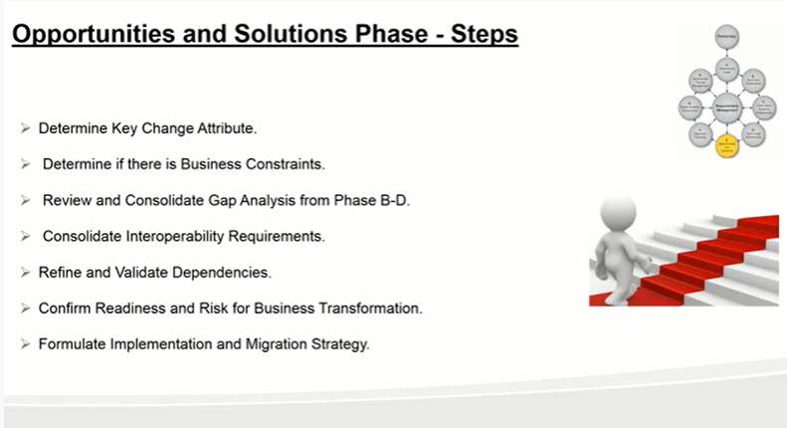
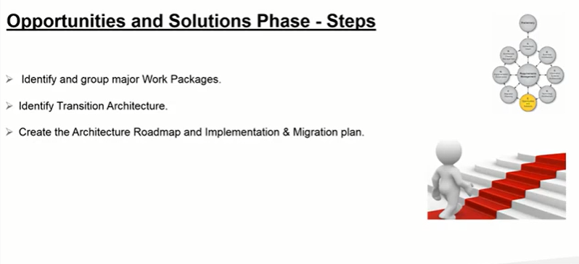

Slide 36
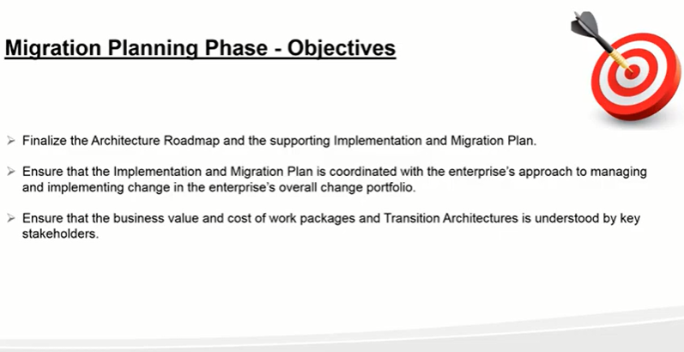

Slide 37
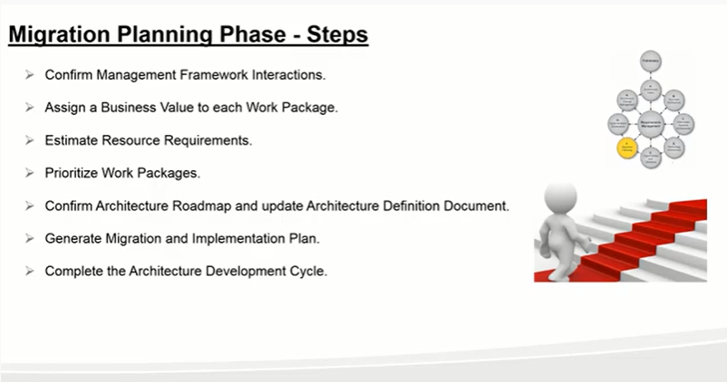

Slide 38
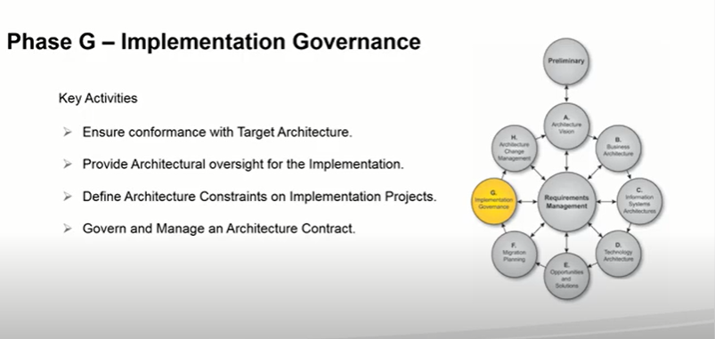

Slide 39
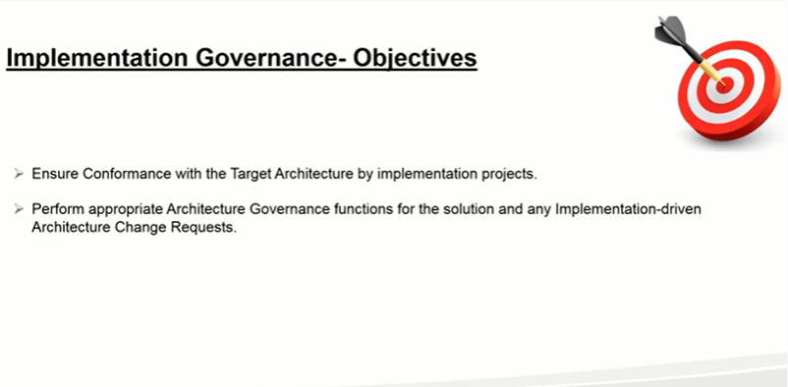

Slide 40
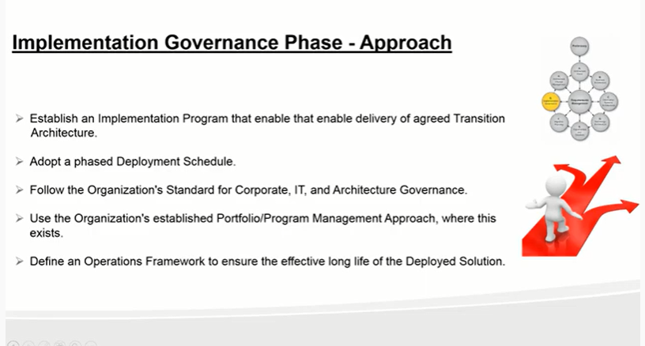
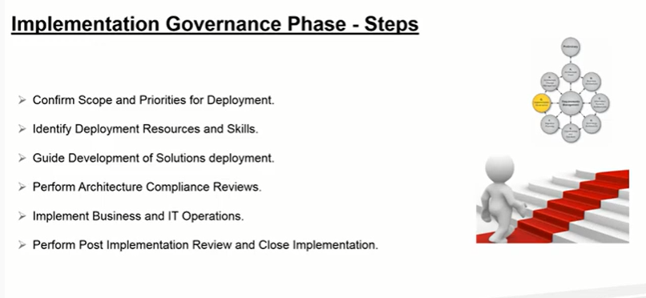

Slide 41
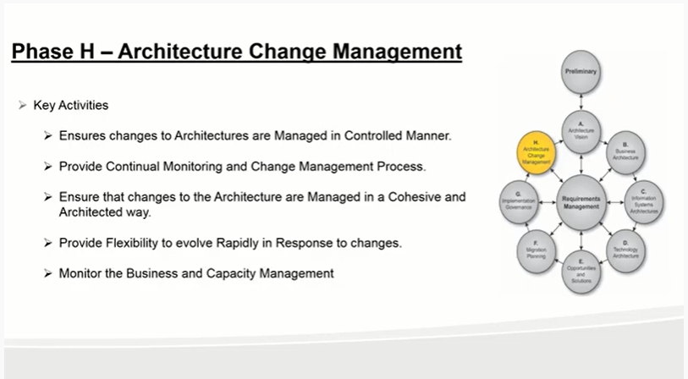

Slide 42
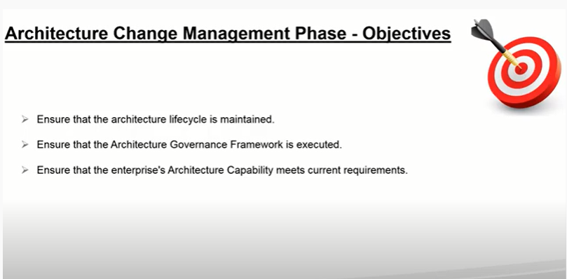

Slide 43
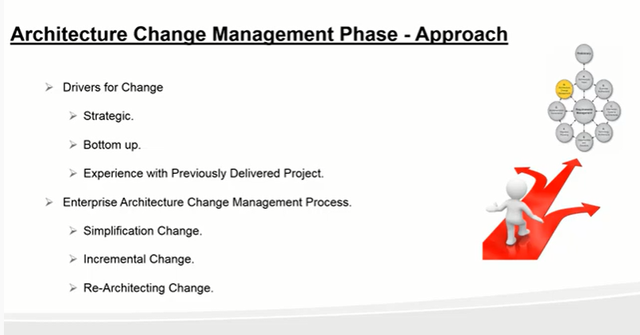

Slide 44
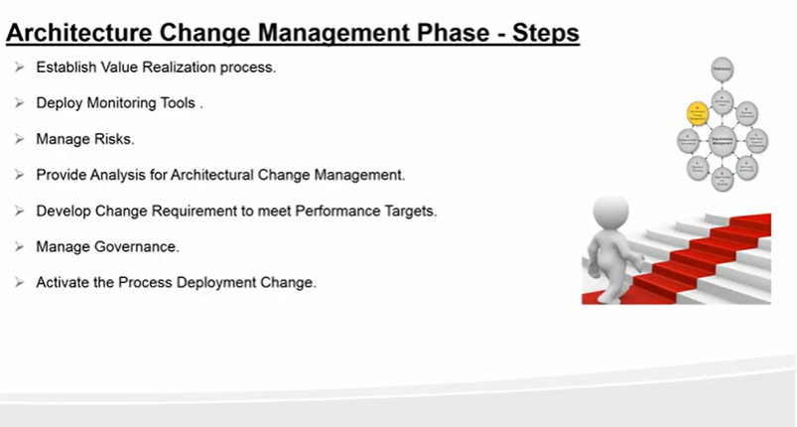

Slide 45
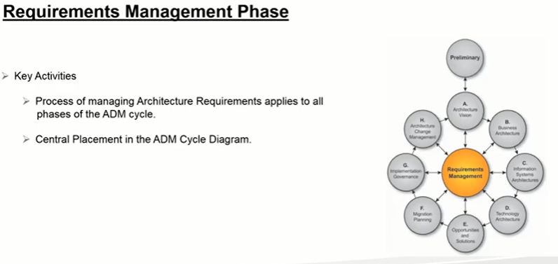

Slide 46
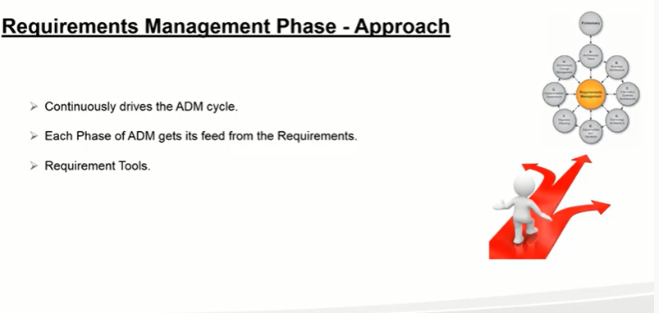

Slide 47
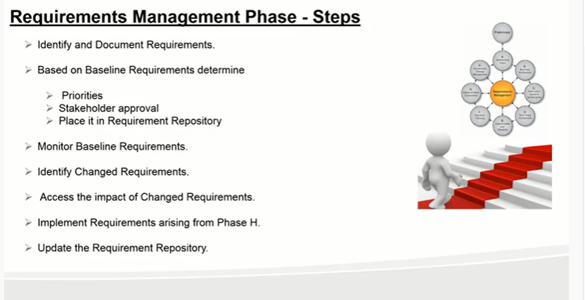

Slide 48
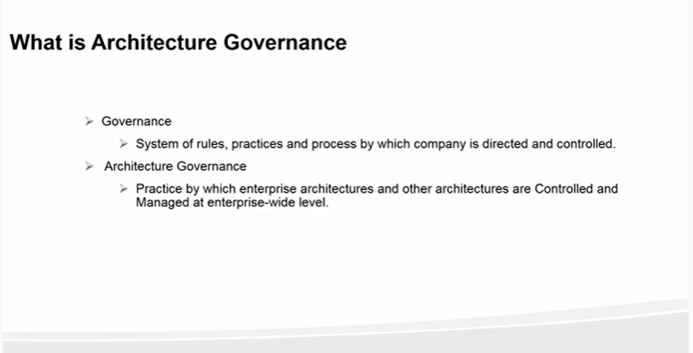

Slide 49
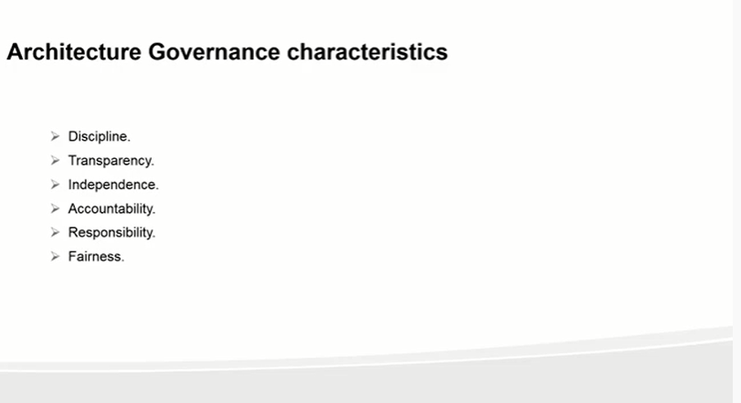

Slide 50
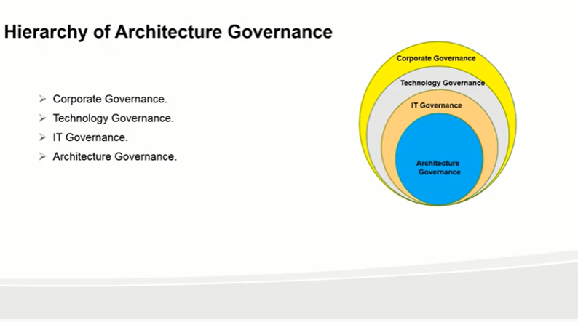

Slide 51
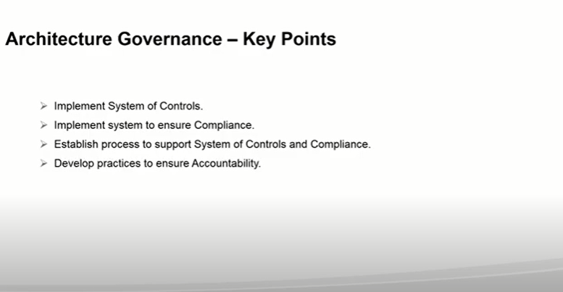

Slide 52
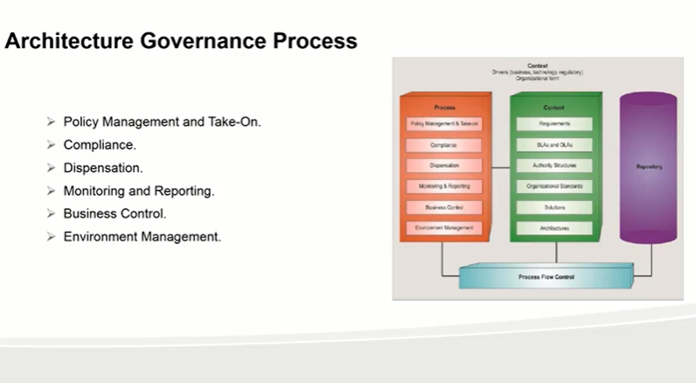

Slide 53
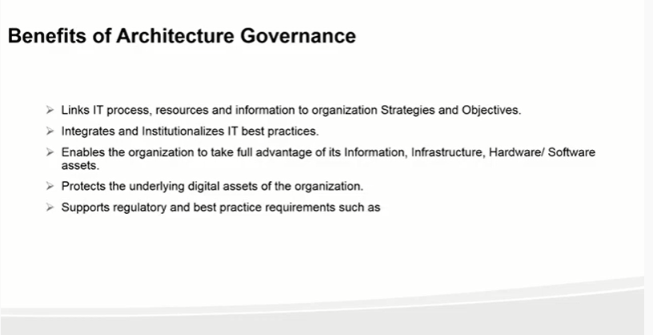

Slide 54


Slide 56


Slide 57


Slide 58

SOW. Time effort and cost

Slide 59


Slide 60


Slide 62
ADM Guidelines and Techniques
Architecture Principles
Stakeholder Management
Architecture Patterns
Gap Analysis
Migration Planning Techniques
Interoperability Requirements
Business Transformation Readiness Assessment
Risk Management
Capability-Based Planning

Slide 63
ADM Guidelines and Techniques
Architecture Capability iterations support the creation¹ and evolution of the required Architecture Capability
This includes the initial mobilization of the architecture activity for a given purpose or architecture engagement type by establishing or adjusting the architecture approach, principles, scope, vision, and governance
Architecture Development iterations allow the creation of architecture content by cycling through, or integrating, Business, Information Systems, and Technology Architecture phases These iterations ensure that the architecture is considered as a whole. In this type of iteration stakeholder reviews are typically broader. As the iterations converge on a target, extensions into the Opportunities & Solutions and Migration Planning phases ensure that the architecture's implement ability is considered as the architecture is finalized
Transition Planning iterations support the creation of formal change roadmaps for a defined architecture
Architecture Governance iterations support governance of change activity progressing towards a defined Target Architecture

Slide 64


Slide 65
Approaches of ADM
Baseline First: in this style, an assessment of the baseline landscape is used to identify problem areas and improvement opportunitiesThis process is most suitable when the baseline is complex, not clearly understood, or agreed upon. This approach is common where organizational units have had a high degree of autonomy.
Target First: in this style, the target solution is elaborated in detail and then mapped back to the baseline, in order to identify change activityThis process is suitable when a target state is agreed at a high level and where the enterprise wishes to effectively transition to the target model.

Slide 66
Architecture Landscape
Levels provide a framework for dividing the Architecture Landscape into three levels of granularity:
Strategic Architecture provides an organizing framework for operational and change activity and allows for direction setting at an executive level.
Segment Architecture provides an organizing framework for operational and change activity and allows for direction setting and the development of effective architecture roadmaps at a program or portfolio level.
Capability Architecture provides an organizing framework for change activity and the development of effective architecture roadmaps realizing capability increments

Slide 67

shows a summary of the classification model for Architecture Landscapes
Architecture Continuum provide a comprehensive mechanism to describe and classify the Architecture Landscape

Slide 68
Architecture Principal
Principles are general rules and guidelines, intended to be enduring and seldom amended, that inform and support the way in which an organization sets about fulfilling its mission.
Enterprise Principles provide a basis for decision-making throughout an enterprise, and inform how the organization sets about fulfilling its mission
Architecture Principles are a set of principles that relate to architecture work

Slide 69
Enterprise Continuum & Tools
The Enterprise Continuum provides methods for classifying architecture and solution artifacts, both internal and external to the Architecture Repository, as they evolve from generic Foundation Architectures to Organization-Specific Architectures.
The Enterprise Continuum
Architecture Partitioning
The Architecture Repository
Tools for Architecture Development
The Enterprise continuum is partitioned into three distinct continua as follows.
Enterprise Continuum : classifies policies, standards, strategic initiatives structures and capabilities
Architecture Continuum: offers a consistent way to define and understand the generic rules, representations, and relationships in an architecture, including traceability and derivation relationships. The Architecture Continuum represents a structuring of Architecture Building Blocks (ABBs) which are re-usable architecture assets. ABBs evolve through their development lifecycle from abstract and generic entities to fully expressed Organization-Specific Architecture assets
Solution Continuum: provides a consistent way to describe and understand the implementation of the assets defined in the Architecture Continuum. The Solutions Continuum defines what is available in the organizational environment as re-usable Solution Building Blocks (SBBs). The solutions are the results of agreements between customers and business partners that implement the rules and relationships defined in the architecture space The Enterprise Continuum classifies architecture assets that are applicable across the entire scope of the Enterprise Architecture

Slide 70


Slide 71
Architecture Repository
system that manages all of the data of an enterprise, including data and process models and other enterprise information.

Slide 72


Slide 74
Glossary:

Slide 75
Gap Analysis: The technique known as gap analysis is widely used in the TOGAF Architecture Development Method (ADM) to validate an architecture that is being developed.
Architecture Governance: Architecture Governance is the practice and orientation by which Enterprise Architectures and other architectures are managed and controlled at an enterprise-wide level

Slide 76

Architecture Governance
Architecture Governance is the practice and orientation by which Enterprise Architectures and other architectures are managed and controlled at an enterprise-wide level.
Key Concepts are…Process, Content, Repository, Processs Flow Control

Slide 78
Architecture Compliance
Ensuring the compliance of individual projects with the Enterprise Architecture is an essential aspect of Architecture Governance (see 44. Architecture Governance). To this end, the IT governance function within an enterprise will normally define two complementary processes:
The Standards Information Base captures the standards with which new architectures must comply, which may include industry standards, selected products and services from suppliers, or shared services already deployed within the organization

Slide 83
Practice Test.

Slide 84


Slide 85





Slide 86





Slide 87





Slide 88




Slide 89



Slide 90



Slide 91



Slide 92






Slide 93




Prioritize projects. Estimate resource requirements and availability. Perform cost/benefit assessment of the various migration projects. Architecture Development Method (ADM) > Phase F: Migration Planning

Slide 94





Slide 95


Architecture Principles: They reflect a level of consensus across the enterprise, and embody the spirit and thinking of existing enterprise principles. Architecture Principles govern the architecture process, affecting the development, maintenance, and use of the Enterprise Architecture. Components of Architecture Principles
Name
Statements
Rational
Implications
Qualities of Principles Understandable, Robust, Complete, Consistent, Stable

Slide 96

The benefits of Architecture Governance include:
Increased transparency of accountability, and informed delegation of authority
Controlled risk management
Protection of the existing asset base through maximizing re-use of existing architectural components
Proactive control, monitoring, and management mechanisms
Process, concept, and component re-use across all organizational business units
Value creation through monitoring, measuring, evaluation, and feedback
Increased visibility supporting internal processes and external parties' requirements; in particular, increased visibility of decision-making at lower levels ensures oversight at an appropriate level within the enterprise of decisions that may have far-reaching strategic consequences for the organization
Greater shareholder value; in particular, Enterprise Architecture increasingly represents the core intellectual property of the enterprise - studies have demonstrated a correlation between increased shareholder value and well-governed enterprises
Integrates with existing processes and methodologies and complements functionality by adding control capabilities
RISK Management

Slide 97




Slide 98




Slide 99




Slide 100




Slide 101




Slide 102




Slide 103




Slide 104




Slide 105



Slide 106



Slide 107




Slide 108



Slide 109

Solution Building Blocks: Output from Implementation Governance (G), input to all

Slide 110




Slide 111




Slide 112




Slide 113




Slide 114

Qualities of Principles Understandability, Robustness, Completeness, Consistency and Stability
The Architecture Continuum consists of which types of architecture

Slide 115




Slide 116



Understandability, Stability, Completeness, Robustness, and Consistency USCRC

Slide 117





Slide 118



Slide 119


